Slide 1
Ant Colony Optimization for Software Project Scheduling and Staffing with an Event-Based Scheduler
Team 12
Jaehoon Choi
Chansu Park
Phan Duy Loc
Eunji Lee

Slide 2
Table of Contents
Introduction
Model description
Proposed Model
Previous Models
Event Based Scheduler (EBS)
Ant Colony Optimization (ACO) Approach
Results & Discussion

Slide 3
Introduction

Slide 4
Purpose of this paper
Previous works suggested their model with Search-Based approach, but they didn’t care at least one part of the following parts:
Employee (Human Resource) Allocation – RCPSP
Task Scheduling – Employee Allocation Models
Task Preemption – Previous Multiskill Scheduling Models (ex: KGA, TS)
(Relatively) Efficient Search Space – Time-Line-Based Model (a.k.a. 3DGA)
This paper suggests an effective approach for the software project planning which take cares
Task Scheduling
Human Resource Allocation
While allowing task preemption and asserting relatively efficient search space.

Slide 5
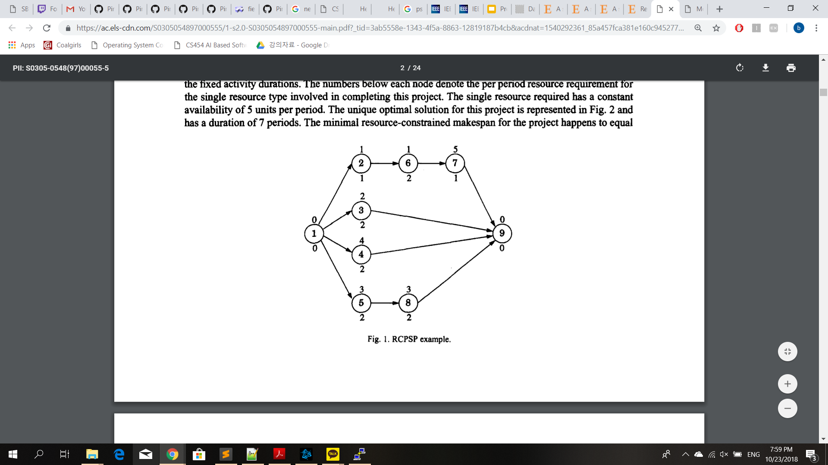
Project Scheduling Problem (PSP)
Given set of tasks in a project, in what order should the tasks be done to minimize time?
Resource constraints can be added
NP-Complete!
(Continue from this page)
(Herroelen, De Reyck, Demeulemeester, 1998 W. Herroelen, B. De Reyck, E. Demeulemeester Resource-constrained project scheduling: A survey of recent developments Computers & Operations Research, 25 (1998), pp. 279-302)
Notes:
The problem is hard to solve so heuristic methods are among the popular choices for solving the problem.

Slide 6
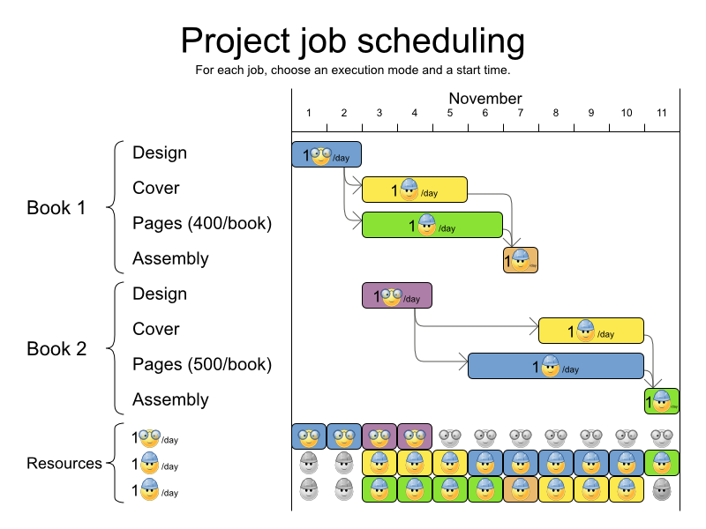
Software Project Managing Problem (SPMP)
Constraints for employees are added
Salary, working hours, skillset, etc.
On top of the PSP, add allocation of employees to each task depending on the required skills
(Alba, Enrique, and J. Francisco Chicano. "Software project management with GAs." Information Sciences 177.11 (2007): 2380-2401.)

Slide 7

T- SPMP
Team efficiency matters
T-SPMP is an extended version of SPMP, which takes team efficiency into account
i.e. certain combinations of employees can increase or decrease task’s duration
Example: A & B may work more efficiently if they have worked with each other before.

Slide 8
Key paper
N. Jin and X. Yao, "Heuristic optimization for software project management with impacts of team efficiency," 2014 IEEE Congress on Evolutionary Computation (CEC), Beijing, 2014, pp. 3016-3023.
The authors introduce T-SPMP as a more realistic problem model and apply only population-based incremental learning (PBIL) algorithm

Slide 9
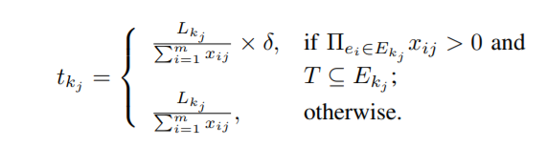
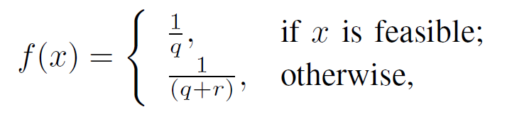
Optimization and constraints
Minimize: Project’s Duration & Cost
Constraints:
Every task is assigned at least 1 employee
Union of skills of employees assigned to task T contains all T’s required skills
Overwork is not allowed

Slide 10
What we will do
Apply various meta-heuristic methods and compare their efficiency in solving T-SPMP in terms of fitness value over a number of evaluations
Tabu search
Simulated Annealing
Ant colony optimization
Non-dominated Sorting Genetic Algorithm II (NSGA-II)
Multi-Objective Cellular genetic algorithm (MOCell)
The methods are subjectively chosen based on surveyed papers

Slide 11
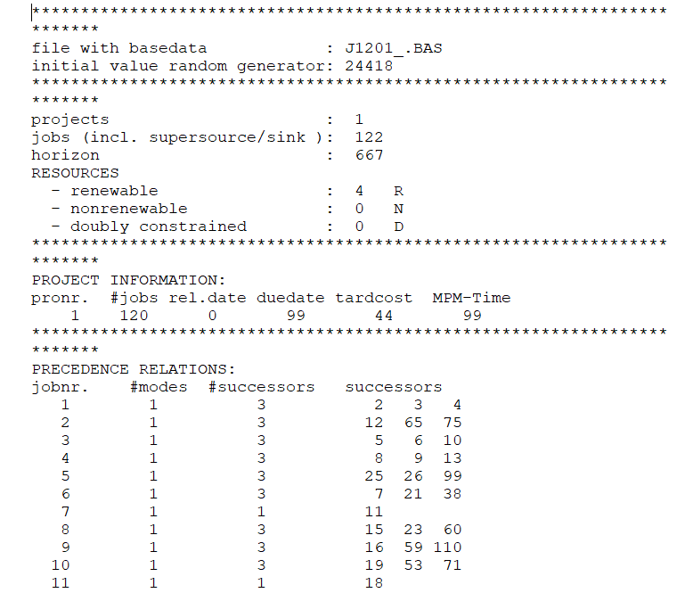
Data set
Data from PSPLib can be altered to generate data for T-SPMP
E. Alba and J. F. Chicano, “An instance generator for the project scheduling problem,” University of Mlaga, Tech. Rep., 2005. [Online]. Available: http://tracer.lcc.uma.es/problems/psp/generator.html

Slide 12
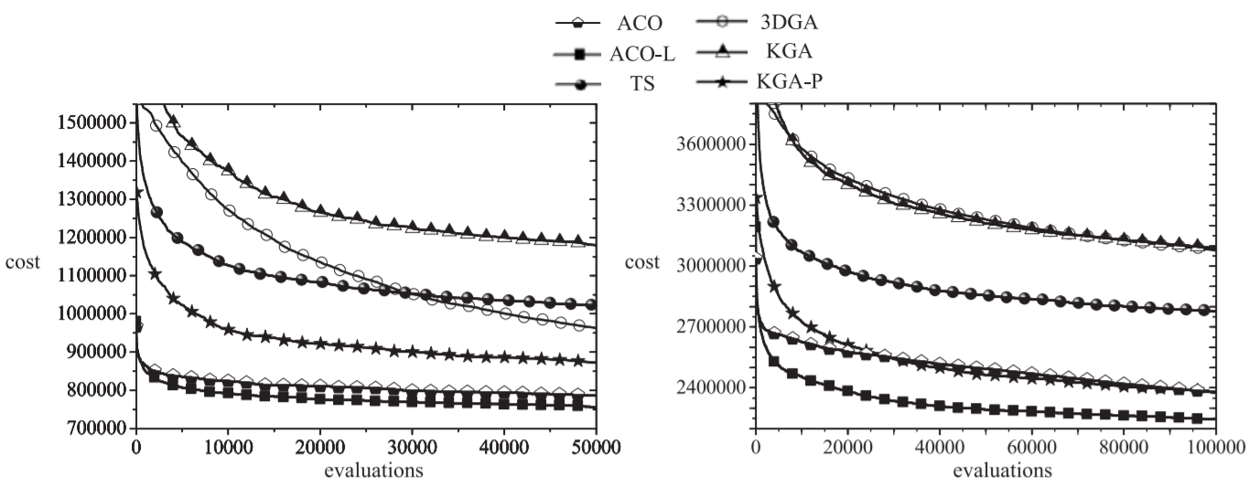
Method of Comparison
See how fitness increases in relation to number of fitness evaluations

Slide 13
Q & A

